Slide 1
Titanic Survival Predictions
Using Machine Learning

Slide 2
About the Data
Features:
Passenger ID, Survived, Pclass (1st, 2nd, 3rd), Name, Sex, Age,
SibSp (Siblings on Board), Parch (Parents on Board), Ticket,
Fare, Cabin, Embarked (from Location)

Slide 3
Method
Explore the data to identify useful features
Prepare the data
Set up the Logistic Regression Model (Machine Learning)
Analyze the Results

Slide 4
Visualising the Data

Slide 5
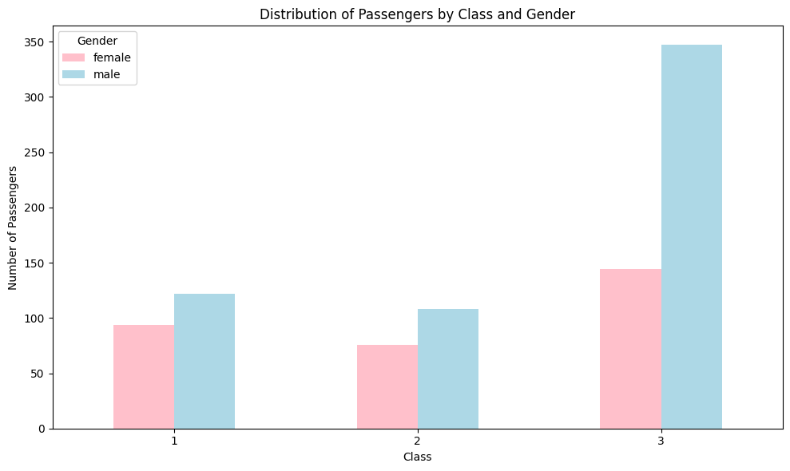

Slide 6
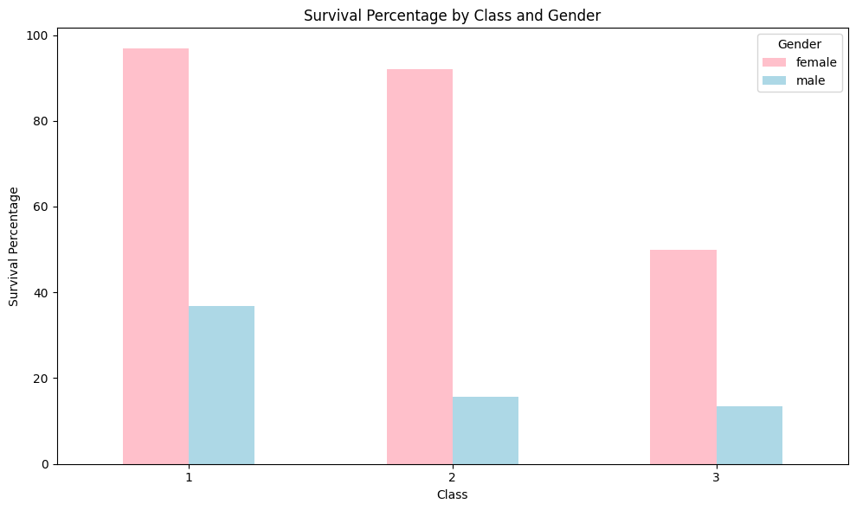

Slide 7
Choosing the Features

Slide 8
Selections and Reasoning
Sex
Women seemed to survive at a higher rate than men
Class
Upperclass seemed to have a better survival rate
Age
Women and children were given priority to board life boats so may play a factor
Another predictor of gender, but uncommon titles like Dr. and Lord may tie into class and survival
Title

Slide 9
Model Results

Slide 10
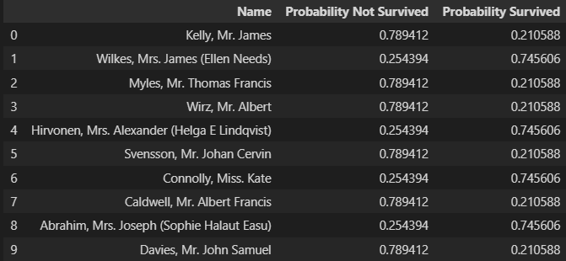

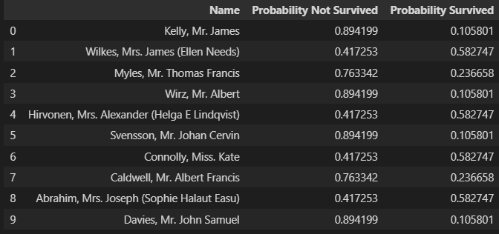

Sex
Sex & Age
Sex & Class
Sex, Class, Age & Title

Slide 11
Summary
Adding in more features seems to produce a higher probability score, meaning that the model is more confident in it’s prediction. Since there is no survival column on the test data, we can only speculate about the model’s accuracy.

Slide 12
Thank you!

